Slide 1
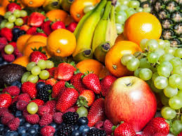

Nutrition Guide
Comparing Mosser and Cedars facilities menus
Amanda Estenoz
Jessica Dumay
Benata Jean Francois
Cristy

Slide 2
Introduction
Purpose: the purpose is to compare the difference of two nursing home facilities. Based on varieties of healthier options for older adults.
Cultural Concentration
White Americans
Age Group : 75 and older
Southeastern and New England region
(Walton, 2015)
Weisman, 2017
Notes:
Some of the southeastern states have been listed as some of the most unhealthy regions in the USA. According to a research done, there has been high cases of heart diseases, diabetes, and cancer.
This has been caused by practicing bad lifestyle behaviors and having a poor diet.
Studies have also shown a high propensity for heart disease due to the southern diet that mainly comprises of fried and fatty foods.
According to the study those who followed the diet had a 56% chance of getting the Coronary heart disease.
On the other hand, New England states are among the healthiest regions in America

Slide 3
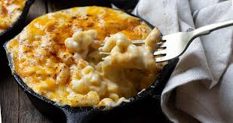
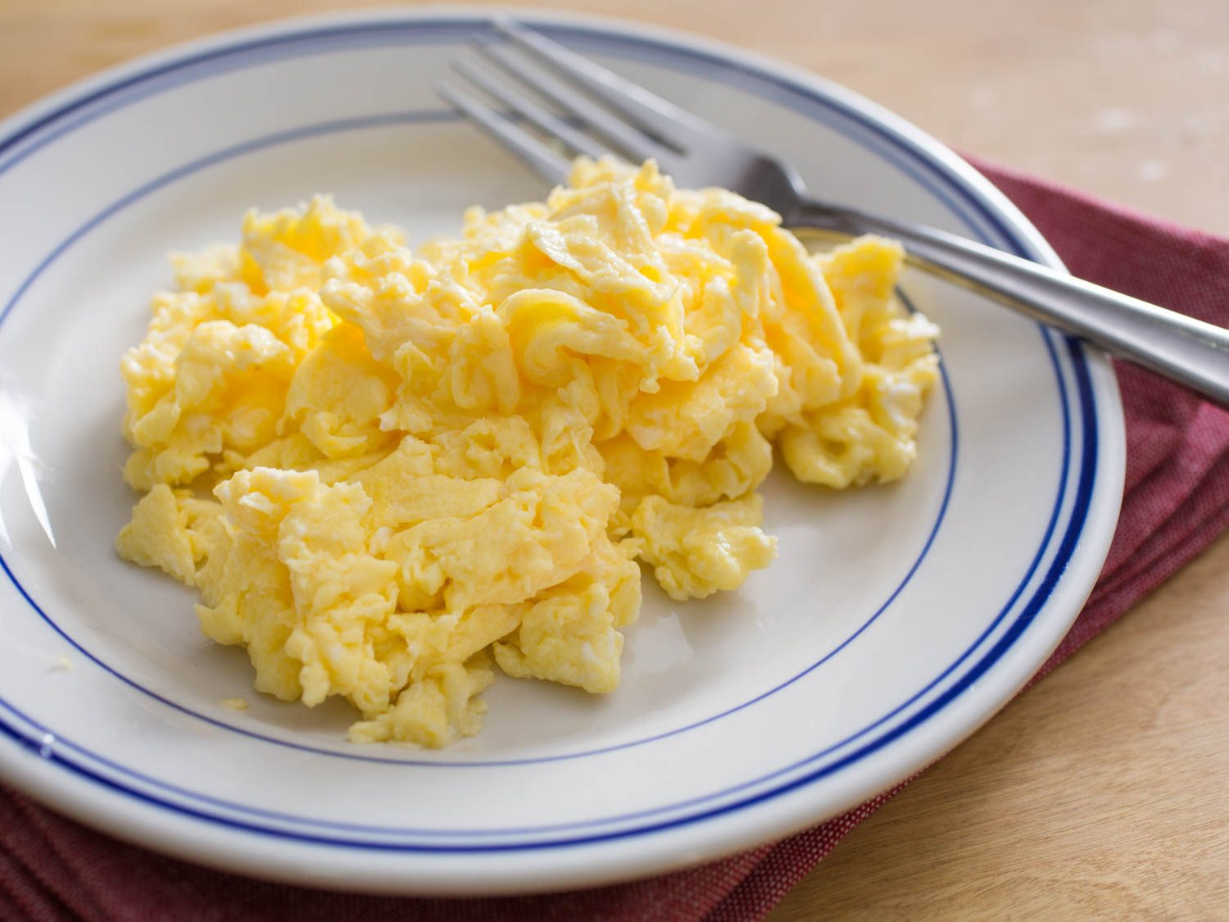
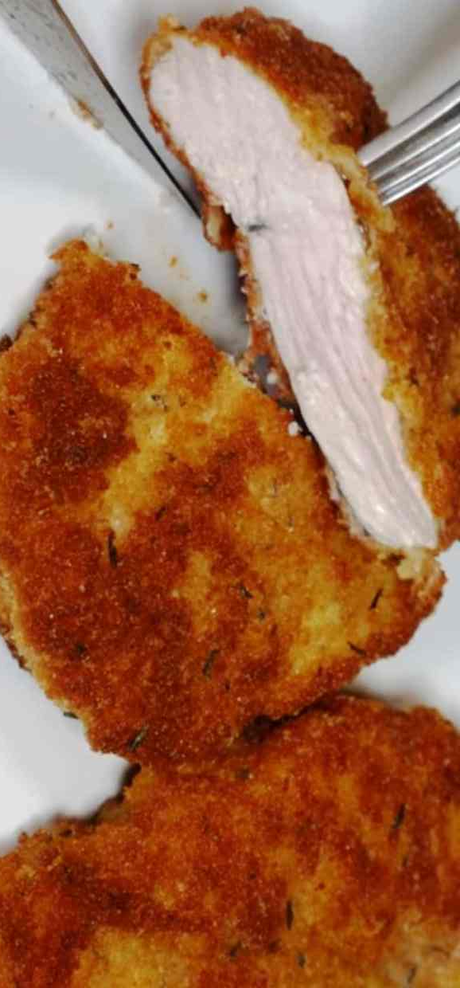
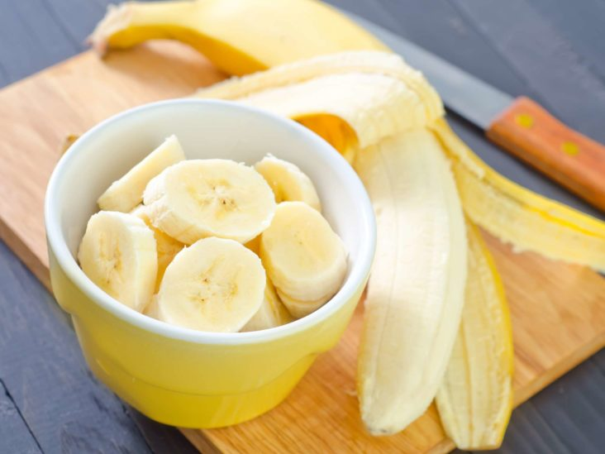
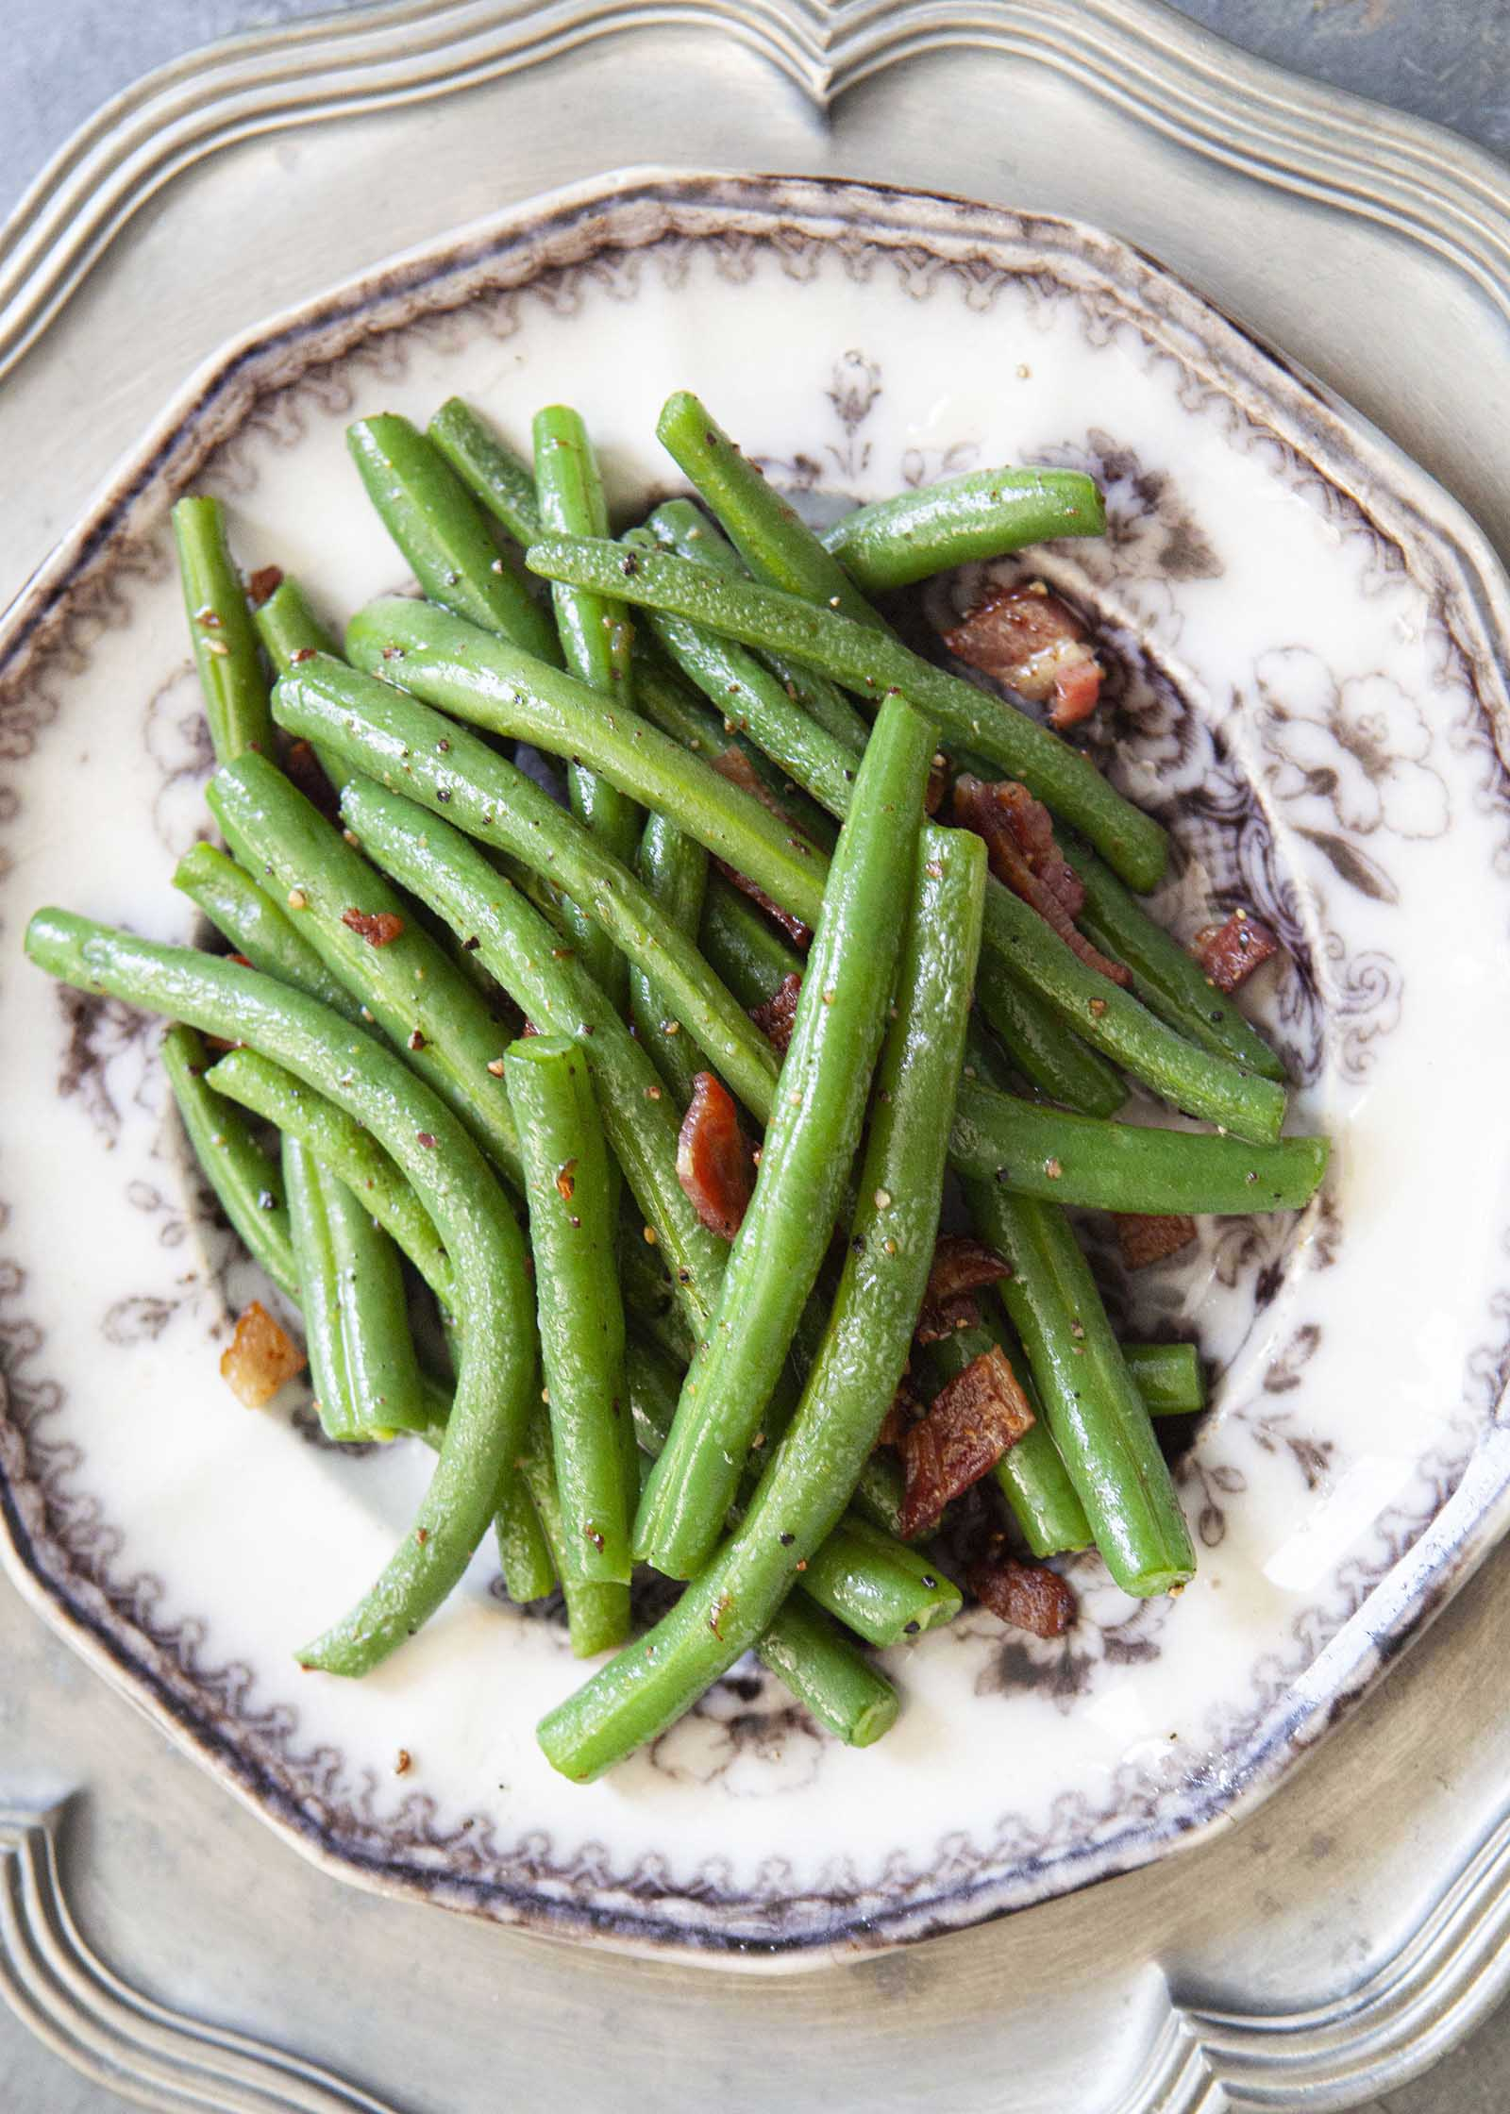

Menus
Mosser, Pennsylvania
Breakfast Oatmeal/scramble eggs Cheese omelet Toast Banana/fruit in session orange sausage /French toast | Lunch Breaded chicken House salad French fries Parsley boiled potatoes | Dinner Tuna melt Top round london Broil Mashed potatoes Raspberry parfait Garlic Bread
Assorted Danish Crisp Bacon Bacon w/syrup waffles | Cheesecake/ Sandwich Macaroni & cheese Chocolate pudding Pound cake | Roast Turkey w/ gravy stuffing Beef Meatloaf Roasted Vegetables Green Beans
Notes:
(Mosser, 2020)

Slide 4
Current Menu Analysis
Healthy Selections:
Banana/fruit in session, orange for breakfast
Lunch selections include breaded chicken and house salad
Dinner includes: Tuna melt, Green beans and mashed potatoes
Unhealthy selections include:
Crisp bacon and bacon & w syrup for breakfast.
Lunch selections include: Cheesecake/ Sandwich, Macaroni & cheese and French fries
Example : Bananas versus crisp bacon
Banana: 0 gram fat, 1 gram protein, carbohydrates(28 grams), 110 calories, 450 mg potassium
Crisp bacon: 233 calories, cholesterol (130 mg), 14.5 g fat, polyunsaturated fat (4g)
Tucker, 2020
Notes:
This slide analysis of the menu for Mosser facilities. The diet incorporates various foods highly influenced by the Irish cuisines. The common diet in these areas include pork, bacon, roast beef, and accompany food with maple syrup.
The diet for the facility is highly influenced by this culture
The unhealthy food however has got high contents of sugars, calories and fats which is not healthy for the age of the people taking the diet.
This may lead to a high risk of obesity and heart diseases.

Slide 5
Current Menus
The Cedars, Rhode Island
Breakfast Choice of Cereal Scramble or Hot boil eggs Choice of juice | Lunch Sausage Peppers and onions Bread Pudding Oven Roasted Turkey Bake stuffed Shrimp Chicken pot pie | Dinner Fruit of the day Pizza night Tossed Salad Chicken Patty on Bun
Muffin of the day Juice of the day Pancake/syrup Raisin Toast | Chicken Cordon bleu Duchess whipped potatoes Soup/ Navy Bean soup Salisbury Steak Sweet potatoes | Cod fish w/crumb topping Jelly w/topping Rice pilaf/Key Largo veggies Tuna on coney Island Tapioca Pudding
Notes:
(The Cedars, n.d.)

Slide 6
Current Menu Analysis
Healthy Selections:
Cereals, juice, and pancake
Lunch selections include Chicken Cordon bleu, Duchess whipped potatoes, soup/ navy bean soup
Dinner includes: Rice pilaf/Key Largo veggies, Tuna on Coney Island
Unhealthy selections include:
muffin pancake syrup for breakfast.
Lunch selections include: sausages and baked stuffed shrimp
Pizza for the night
Example : Cereals and Muffin Cake
Cereals: cereals provide fiber and protein and many numerous minerals and vitamins such as the B vitamins (thiamin. Riboflavin, folate, iron phosphorus, and magnesium)
Crisp bacon: pizza slice has 285 calories, 10.4 grams of fat, 35.7 g of carbs, 12.2g of proteins, and 2.5g fiber
Notes:
This slide analyses the common foods that eaten in the Cedars, Rhodes island.
In the south eastern region the diet consists mainly of greens, barbecue, fried chicken, pork and ham.
Most of these foods have less nutrional values but contain fats and a lot of sugars.
Over the course of the day however the individuals are provided with a balanced diet.
Despite the culture of food that may lead to diseases such as heart disease. The diet has manage to introduce cereals which are of high nutritional value.

Slide 7
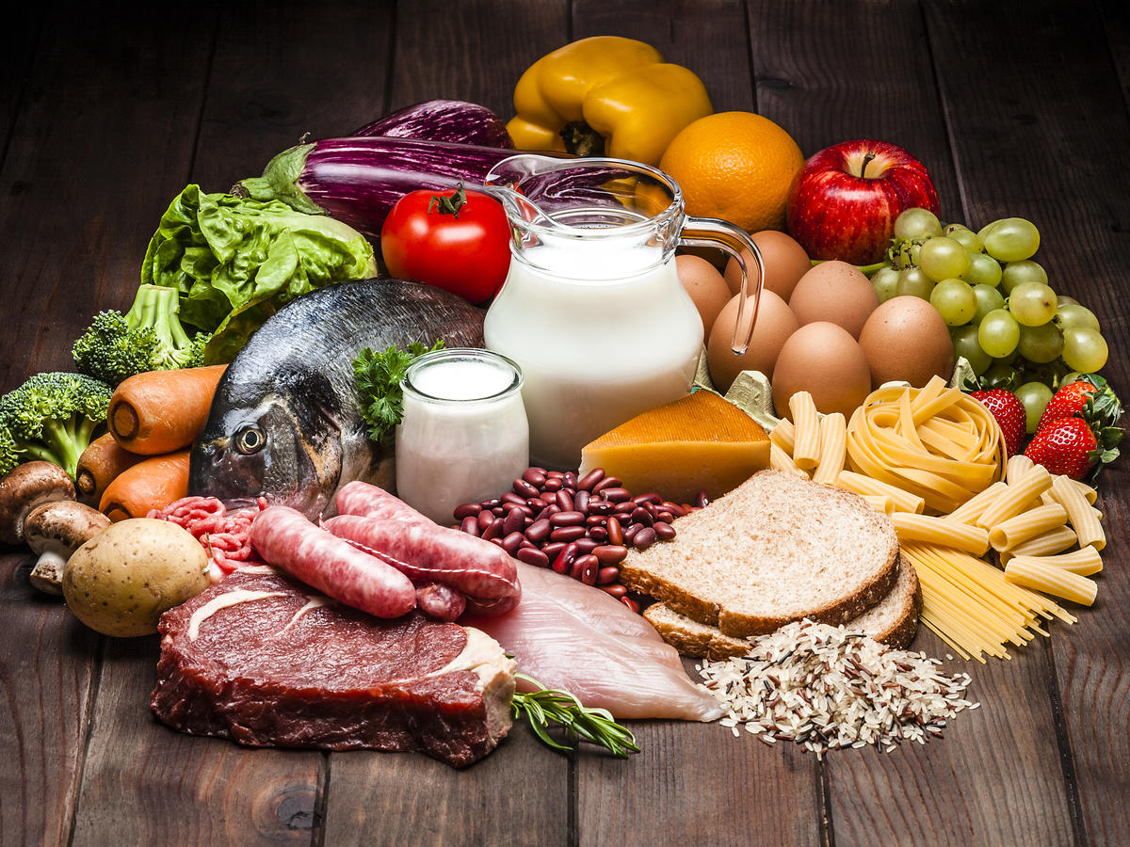
Sample Menu Mosser, Pennsylvania
Breakfast | Poached eggs, egg of choice, fresh juice, oat waffles, sausage
Lunch | Fried rice, pork roast teriyaki, baked potato, mixed vegetables. fruits
Dinner | Vegetable Medley, pasta salad, broccoli raisin salad, tasty tuna, fruits
Notes:
The menu provided offer better nutritional value because the contain all the essential nutrients required for this age groups.
For every meal the person is provided with some fruits to increase the level of vitamins in the body. This helps boost the immunity of the body.
The original foods were filled with fats and empty calories but these have been replaced with waffles and better cereals.
Poor nutrition leads to more burden of disease are the old do not recover quickly

Slide 8
Sample Menu The Cedars, Rhode Island
Breakfast | Cold cereal, banana. Egg of choice, fresh fruits, hash browns, 100% juice
Lunch | Baked Tilapia, Glazed Carrots, Herb mashed potatoes, Green beans, Parmesan Pork Chops, Baked roll
Dinner | Pulled pork BBQ, Baked beans, Broccoli Ham Casserole, Picnic Salad Bowl, watermelon, corn dog
Notes:
Diet considerations for an aged population is important.
As they are prone to high risk diseases due to the diet is is important to check it as their immunity is low.
The proposed diet helps them to grab a heavy breakfast as they begin their demand can also choose to take some juice to boost their vitamins.
The foods also promise to deliver energy needed for the day without leaving them with a lot of fats which may lead to heart diseases.

Slide 9
Menu Comparsion
The original Nosser menu contains a lot of calories and unwanted fats. For instance the Crisp bacon and bacon & w syrup for breakfast. Cheesecake/ Sandwich, Macaroni & cheese and French fries taken for lunch only increase the fat levels an offers very low nutritional value.
Baked potato, mixed vegetables. Fruits on the other hand have more nutritional value and helps in he digestion process.
The Cedars original menu has a lot of unsaturated fats too. It also has got sodium such as in pizza. By replacing this with healthy foods such as Baked beans, Broccoli Ham Casserole, Picnic Salad Bowl and watermelon, help improve the nutritional value only offering the best
Notes:
It is important to watch the diet of the elderly to avoid pushing them into diseases that come with old age.
Menus should always be developed with the assistance of dietitian to ensure its effective.
High increase of fats and sodium in the body only leads to a deteriorating body with the immunity levels going down too.
Where the aged lack micronutrients means the onset of infections in the body.
It is crucial to always monitor what they are eating for them to liv longer with us

Slide 10
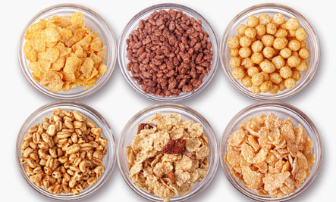

Dietary choices
Natural ingredients, fruits, cereals or sans dairy fat are highlighted in a smart diet plan; lean meats, poultry, seafood, grains, eggs and peanuts are included;
Eating a range of foods from all dietary categories will gracefully support the supplements and individual needs as they age.
Ellis, 2019
Notes:
Ensure the fats eaten are polyunsaturated and monounsaturated fats. Change from strong fats to oils .
Fluctuate protein decisions with more fish, beans and peas.
Eat foods grown from the ground. They can be new, solidified or canned. Eat more dim green vegetables, for example, verdant greens or broccoli, and orange vegetables, for example, carrots and yams.
Eat at any rate three ounces of entire grain oats, breads, saltines, rice or pasta consistently. Pick entire grains at whatever point conceivable.
Have three servings of low-fat or without fat dairy (milk, yogurt or cheddar) that are strengthened with nutrient D to help keep your bones solid.
Ensure the fats you to eat are polyunsaturated and monounsaturated fats. Change from strong fats to oils while planning food.

Slide 11
Barriers
Resistance to change
Digestive tract diseases
Changes in social support
Eating alone
Vision impairment
(Miller & Steinle, 2020)
Notes:
In everybody, the hindrances to smart dieting appear to be identified with topics of time, food inclination, and absence of self control. Nonetheless, the boundaries to good dieting in the more established populace will in general contrast. Time and taste appear to be hindrances less regularly. All things considered, arising obstructions special to this age bunch grow, for example, social determinants, medical conditions, and diminished monetary and social help. Besides, this age populace appears to battle with change more than other age bunches as the examinations found that "surrendering enjoyed nourishments" and "protection from change" were obstructions one of a kind to this age companion

Slide 12
Summary
Main points.
It is important to check daily food intake to ensure that the required allowance is eaten
The only way to avoid diseases and malnutrition is by ensuring a balanced diet everyday.
Culture has a huge influence on what people eat.
It is crucial to understand that despite the culture, bodies respond differently to what you eat. Therefore watching the diet should be a first priority
Notes:
It is always important to eating just the right portion of food as any excess just goes into waste or stored into fats while less food leaves the body weak.
Diets should mainly contain whole foods rather than manufactured foods.
Culture may pressure a person to take up foods that may end up posing a health risk later. It is therefore important to approach these foods carefully.
The elderly in care homes should be advised despite been provided with culture friendly foods, they should always be wise with their choices

Slide 13
References
Cedars. (2020). Dining Menu. The Cedars. https://cedarsliving.com/library/dining-menu/.
Ellis, E. (2019, October). Healthy eating for older adults. Eatright.org - Academy of Nutrition and Dietetics. https://www.eatright.org/food/nutrition/dietary-guidelines-and-myplate/healthy-eating-for-older-adults
Miller, A., & Steinle, N. (2020). Barriers to Healthy Eating in the Elderly; A National and Global Perspective. Journal of Human Nutrition & Food Science, 8(1), 1-5. https://www.jscimedcentral.com/Nutrition/nutrition-8-1130.pdf
Mosser Nursing Home. (2020). Monthly Menu for Mosser Nursing Home in Lehigh County, PA. Mosser Nursing Home. https://www.mossernursinghome.org/our-facility/our-menu/.
Tucker, A. (2020, October 17). 75 classic New England foods. New England Today. https://newengland.com/today/living/new-england-nostalgia/75-classic-new-england-foods/
Walton, A. G. (2015, August 10). Study: 'Southern Diet' Strongly Linked To Heart Disease. Forbes. https://www.forbes.com/sites/alicegwalton/2015/08/10/southern-diet-linked-to-heart-risk-study-finds/?sh=5da162e533ae
Weisman, J. (2017, February 1). Four New England states among nation's healthiest. New England Psychologist. https://www.nepsy.com/articles/leading-stories/four-new-england-states-among-nations-healthiest/

